Slide 1
Adding Reflections to Sunglasses
Morgan Hale

Slide 2
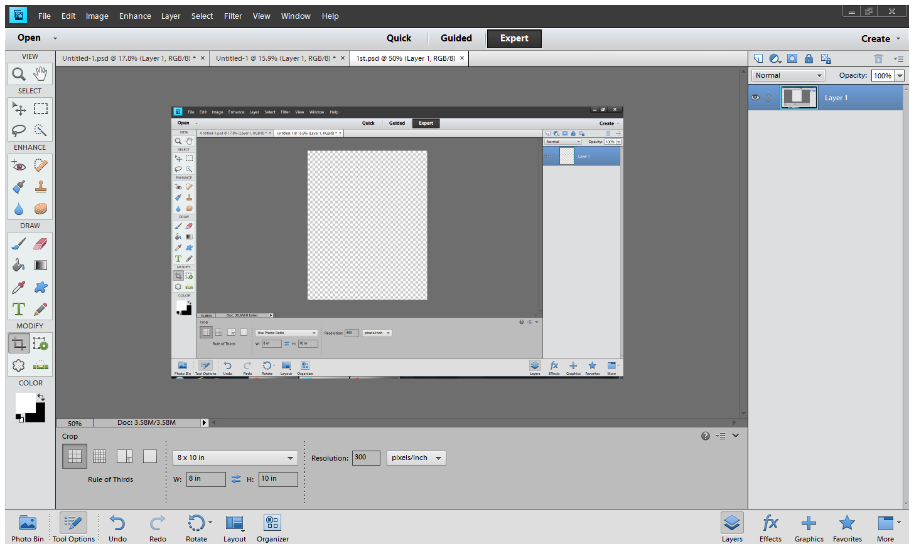
First you open up a new document in Photoshop. Make it 8x10 with a resolution of 300.

Slide 3
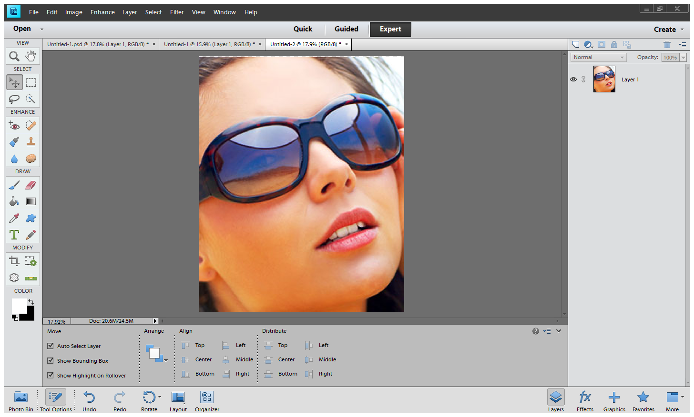
Put your image into the document and stretch it out to make it fit the plat form.

Slide 4
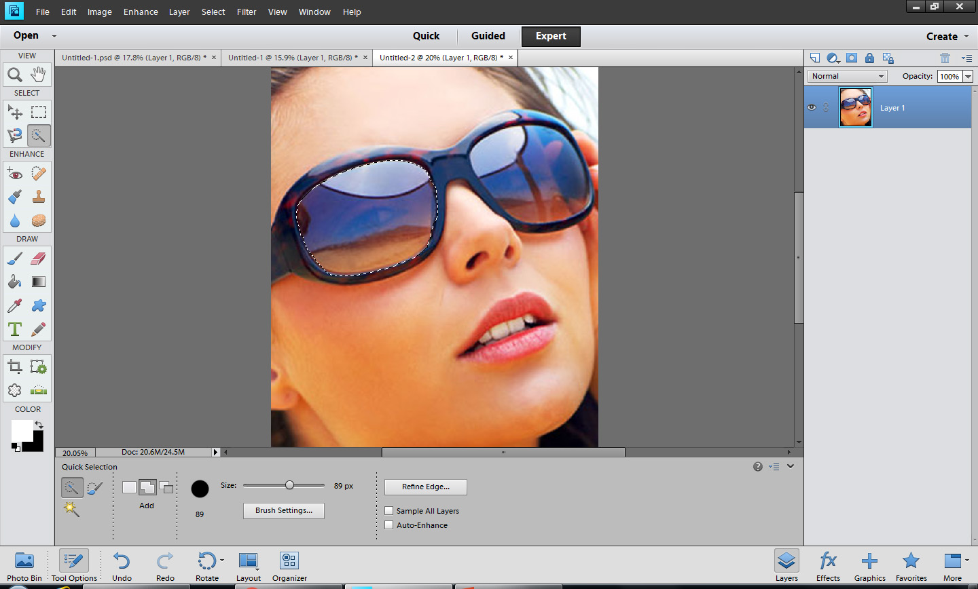
Take the magnetic lasso tool and go around the lens, try to make it around it the best you can.

Slide 5
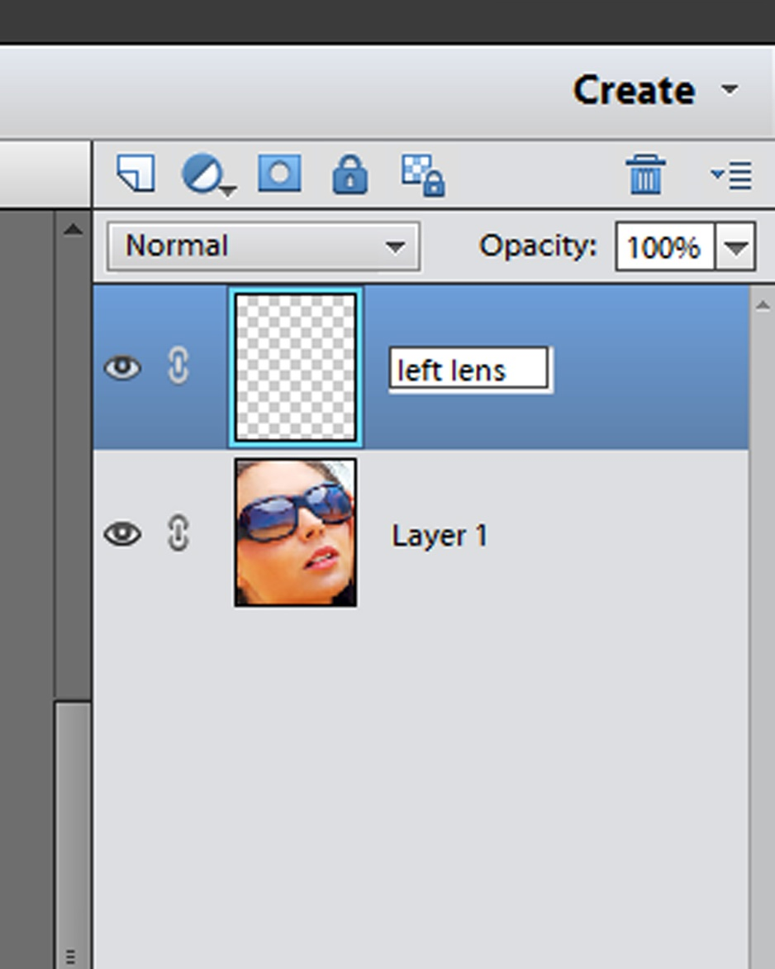
Make a new layer while the lens is still selected and name it “left lens”

Slide 6
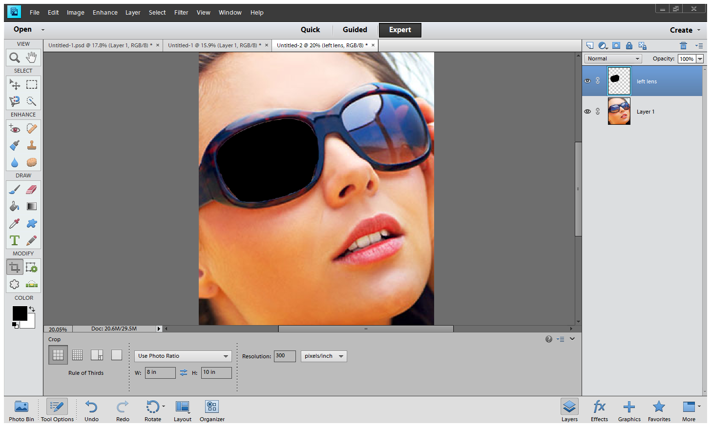
On the “left lens” layer, change the background color from white to black and do alt and backspace at the same time to make the lens all black.

Slide 7
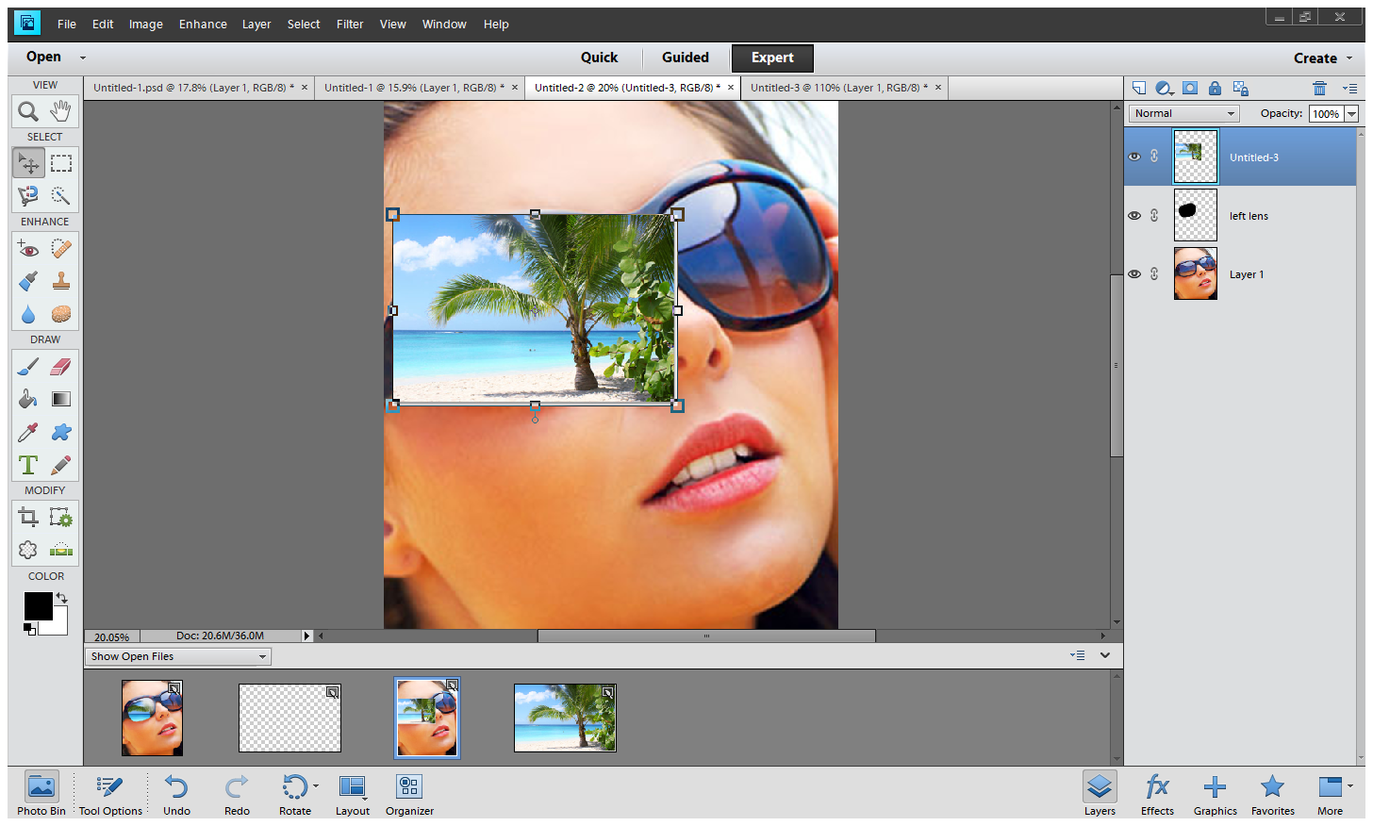
Drag the beach image onto the women image.

Slide 8
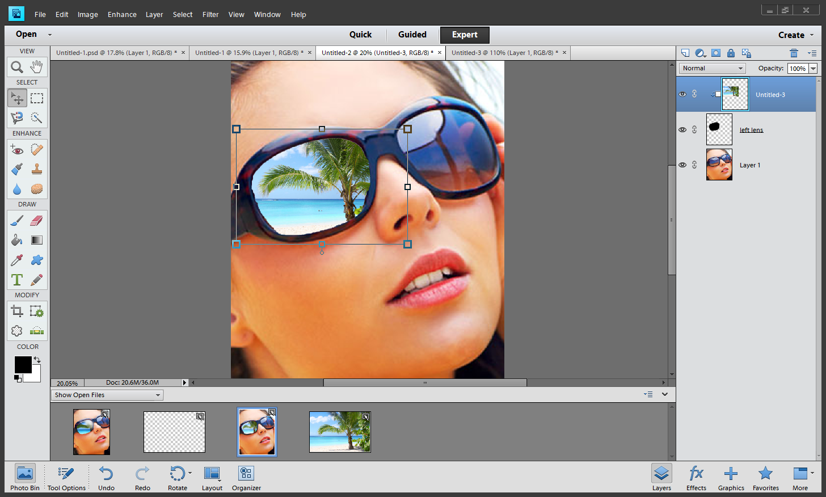
Next wrap the beach image around the lens by taking the two layers on the layer page and going between them with the alt key and click once the pointer changes to this….. And don’t forget to name the beach layer “left reflection”

Slide 9
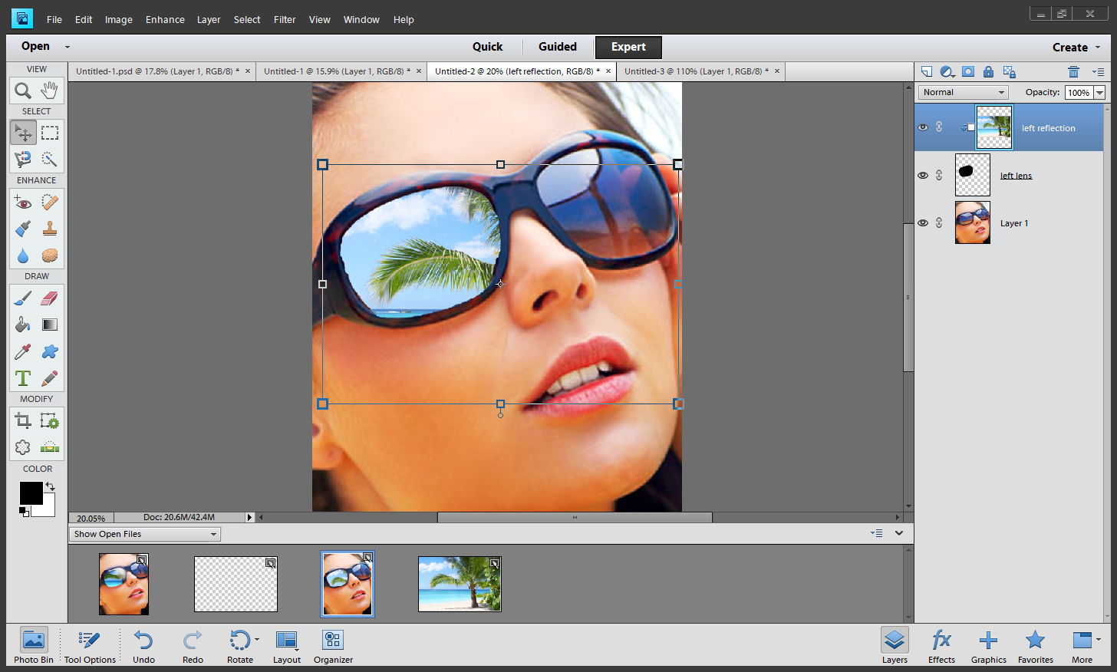
Move the image to the way you want it so that in the right lens, it can match up. (see how I moved the beach image)

Slide 10
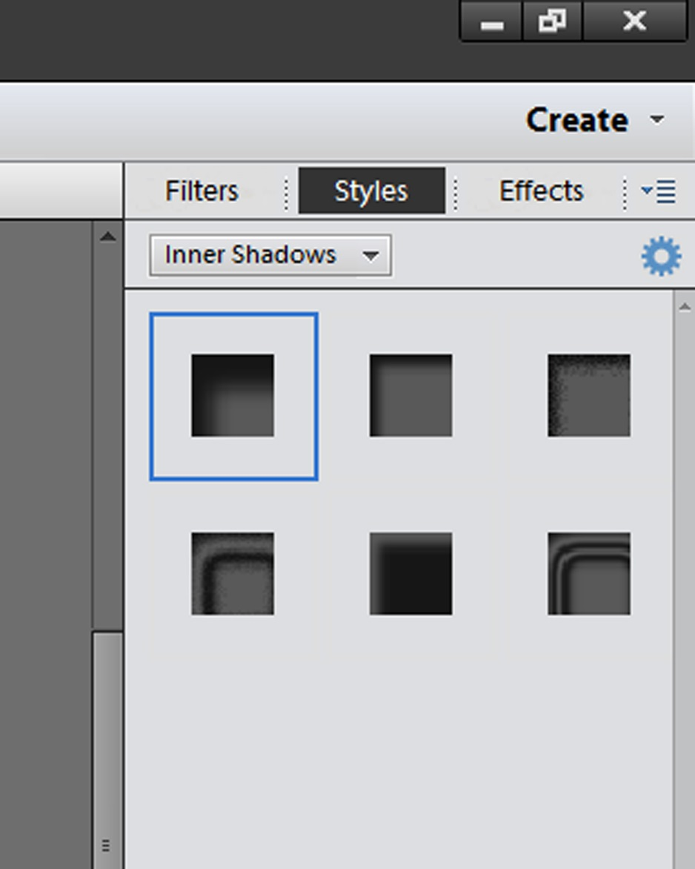
Click on the layer “left lens” and go to effects then styles and on the scroll bar underneath it go to inner shadows, choose any shadow type you want or looks good

Slide 11
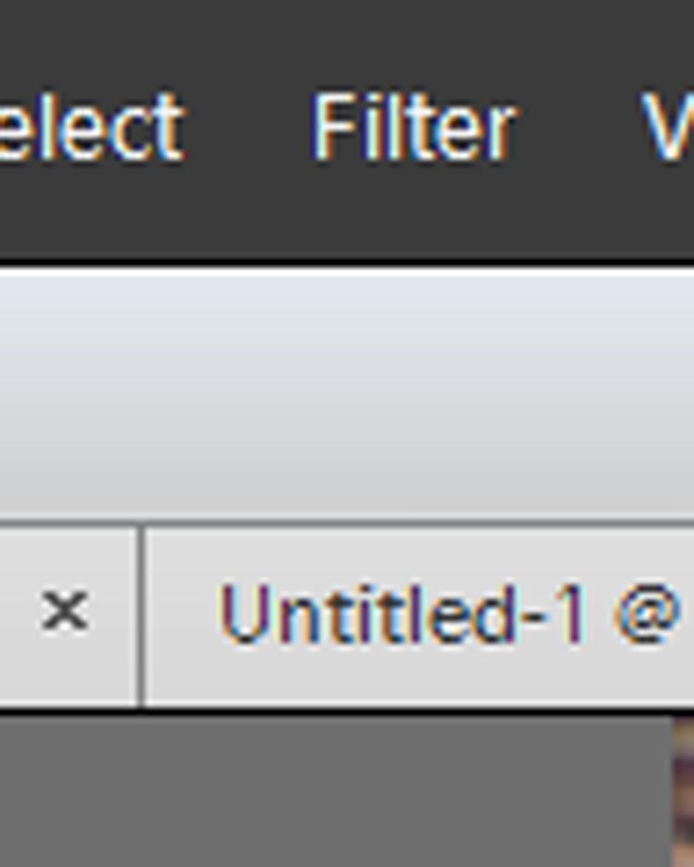
Now click on the “left reflection” layer and go to the filters on the top left of page and g to distort then click spherize

Slide 12
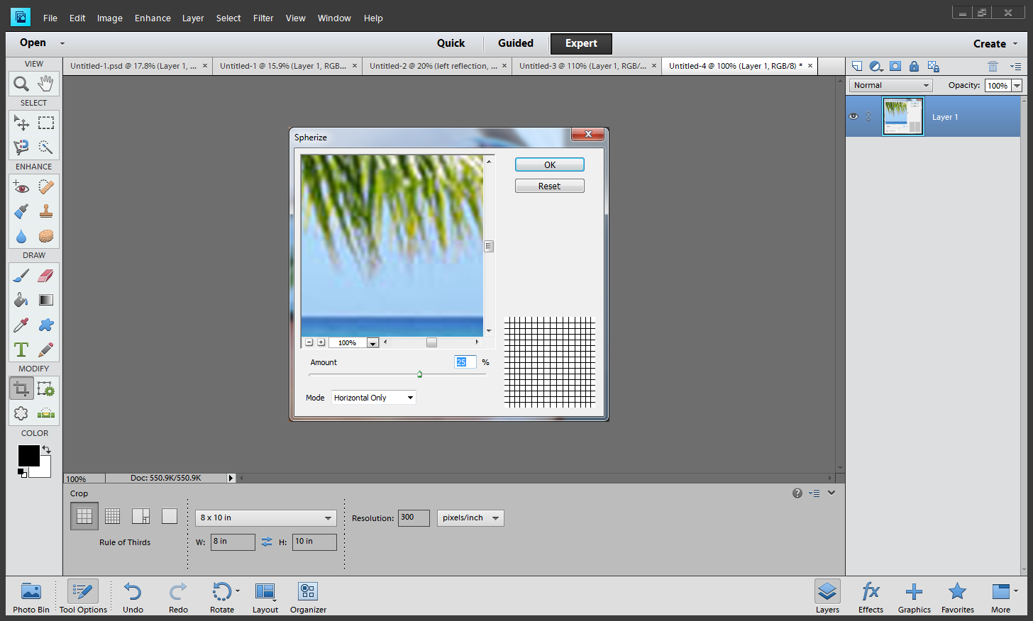
Make the image horizontal only and 25-30% (its your choice)

Slide 13
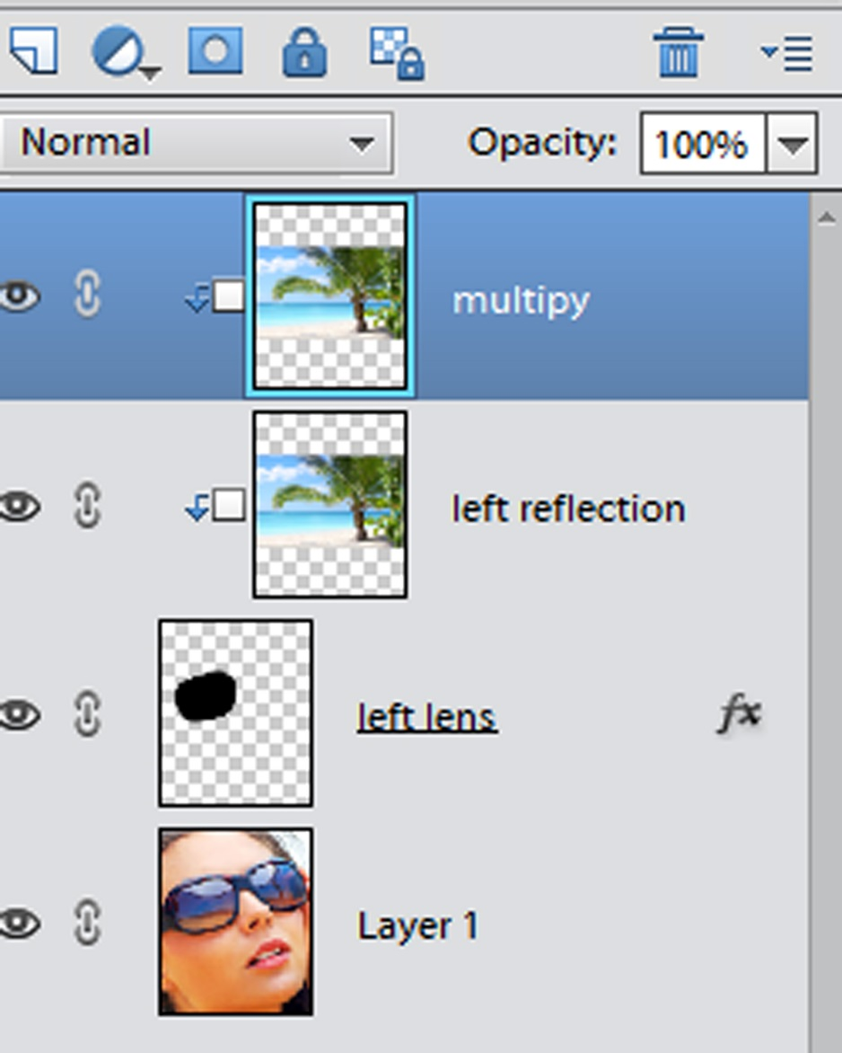
Next copy the left reflection layer by control J and then change the new layer name to “multiply” and wrap the image with the image you copied it from (alt, click between)

Slide 14
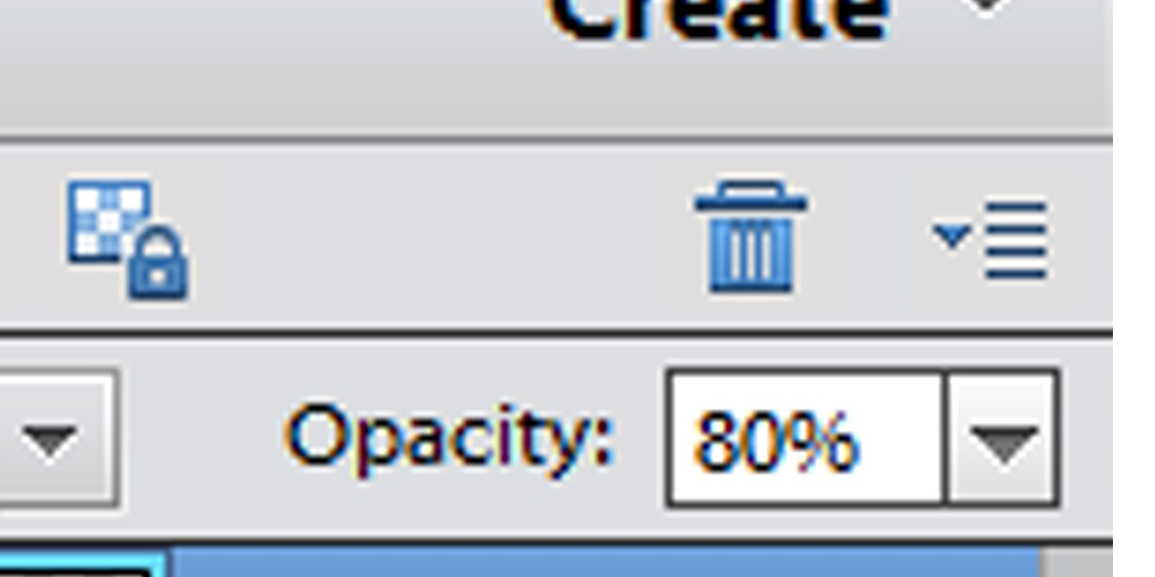
Drop the opacity on the “left reflection” layer to 80%

Slide 15
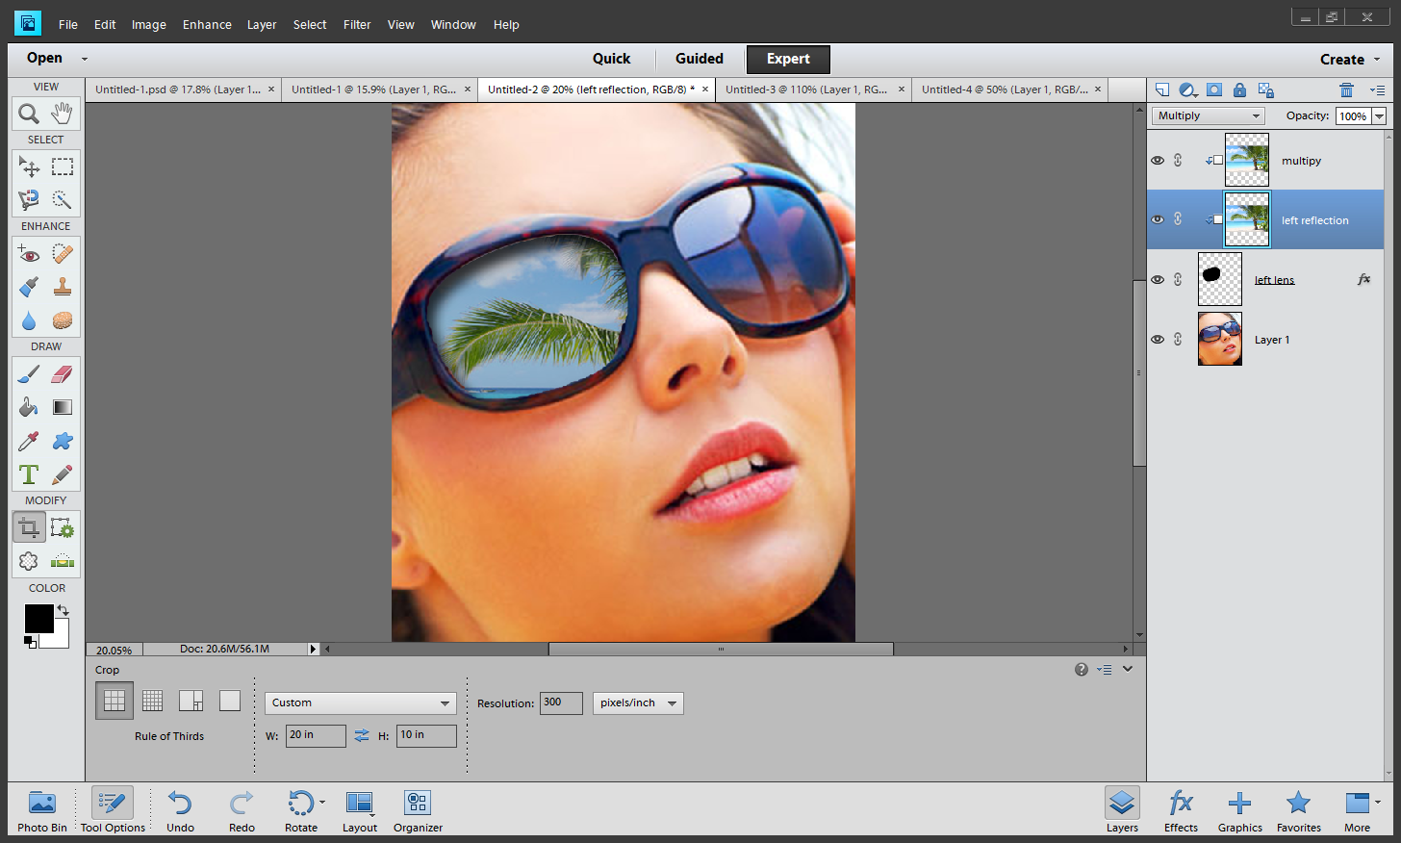
Add the blend mode “multiply” to the left reflection layer

Slide 16
Now do it ALL again for the right lens☺☺☺

